Slide 1
Paper presentation: empirical assessment of MDE in industry
Erik Wang
CAS 703

Slide 2
Overview
Background of the research/paper
Research approach
Conclusion

Slide 3
Background
To know how MDE works in real world
Find out “successful factors” and “failure factors” to business
Find out what are the key factors to make MDE better
Notes:
We have success, but also have failure
Some issues: what is the benefit? Does MDE help increasing productivity? Or is productivity the only thing companies seek for?
Synchronize model and code

Slide 4
Research purpose
Previous similar research
paper study
suggest do empirical study
This research
Published in 2011
Report a 12 months research study from industry
Face to real industry / people
Find advantage and disadvantage of MDE
Quantitative and Qualitative
Notes:
Previous study was based on paper study – experience reports from single projects.
Focus on the impact of MDE on productivity and software quality
Question and Interview
MDE participant and professional
(Diversity of subject, widespread coverage
Reflect their experience and expertise to explore greater detail and depth aspects)

Slide 5
Methods to collect data
MDE is sort of management
Collect data (response from industry)
Questionnaire
Interview
Onsite observation
Notes:
MDE is sort of management
The first thing is to think how to gather data – from the industry?

Slide 6


Questionnaire
Use Paired questions to find pos/neg
Involve practitioners with different background
General – most people think it is good, but just half believe it is successful
Notes:
By personal email, email list, survey link on the OMG website
Online survey, take 15 minutes
Good but not successful – black berry, it is cool, physical keyboard make it so different, but seldom people but it

Slide 7
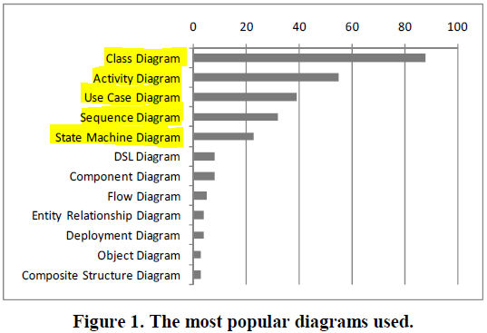
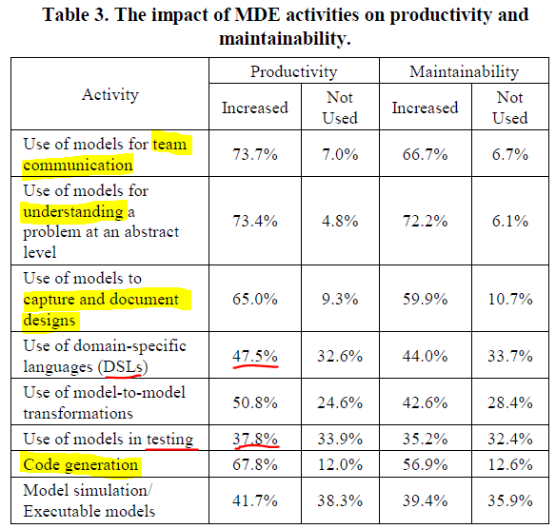
Use MDE and affect to productivity
MDE provides a standard to improve productivity
and maintainability.
But some features seems not useful
Notes:
UML diagram can well present the abstraction business requirements
Not popular diagram which is not to close to business (but software implementation)

Slide 8
Questions
Positive | Negative
Improve flexibility of requirement change | Not help business opportunity
Improve Code generation | Not doing well in Round-trip-engineering
Improve understandability | Doubt why modeling !!
… | …
 | Tool is too expensive
Summary:
Balance between positive and negative
A successful MDE adopt need consider every single factor, decisions should intend to maximum the benefit of MDE
Notes:
The result also reflect some subjective attitude to MDE

Slide 9
Interviews
Discussions with experienced professionals
30 minutes talk
Dig information behind projects
What is the concern of adopting MDE
Notes:
20 interviews

Slide 10

Interview – motivation
Choosing the correct project which to introduce or Trail MDE
Motivating process change:
Unless existing process has a significant risk
Motivating project success
Put MDE in critical path of project, take risks
Notes:
Some times organization don’t have capacity to put MDE as parallel or pilot
So the organization and MDE users must be motivated to use MDE is make it a success, faith

Slide 11


Interview - people
Not everyone can think abstractly
Technical view - Details in design and programming
Culture view - People see negatives, don’t want to change
To find out why people don’t want to change?
Notes:
Newly engineering are good candidate to be modeler where gurus don’t want to change (own concerns)
This is a culture issue rather than technical issue
Cock changed its logo / font / out-looking

Slide 12
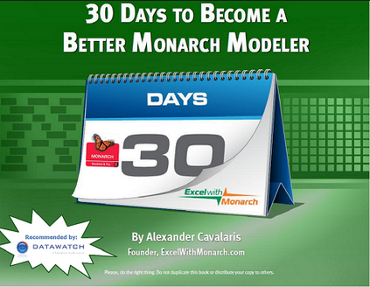
Interview – Modeler resource
Training, Education and Related Perceptions
Need few modeler but many support engineer
Trained modelers are fewer than programmers
Notes:
Modeler are very good at modeling, but don’t need too many
Employees consider from business stable view, prefer more resource who can programming
One reason is that modeling is not well included in programmer training
An ideal situation is that programmers can also well use modeling

Slide 13
Interview – Best practice
Keep domains tight and narrow for DSL
There is no need to include all features to DSL
Strong product oriented definition of DSL
Notes:
Scope creep in project management
More suitable to embedded software

Slide 14

Interview – Concern point of benefit
Successful MDE users often have to lie
People won’t believe the significantly increasing productivity
More valuable contributions to improve quality and consistency
Notes:
People won’t say because organization politics
Productivity is not the only even necessary improvement to SE

Slide 15

Lower-level analysis
Domain leader
Culture – people’s perception affects decision
Expertise – seek for more experience
Evangelism – need a domain leader
Being a people like that:
Opinion leader
Open minded
Can-do type people
Passion
Notes:
People don’t have confident to MDE
Be a wise guy

Slide 16
Conclusion
MDE still in evolution
Try to fit for to real industry
Technical, social, organizational factors
Social
Organizational
Technical
Notes:
We still need to evolve MDE, from either technical aspect and other aspects

Slide 17
Questions and Discussion

Slide 18
Discussion – the research
The research
Is this research a good one?
What is the advantage? What is the issue?

Slide 19
Discussion - MDE
Talking about MDE
What is your most interest benefit of MDE?
What is your concern about MDE?

Slide 20
Backup slides

Slide 21
MDE in the balance 1
Training
Require significant extra training
Responding to requirement changes
MDE helps to flexible requirement change
Not help in responding new opportunities
Code generation
Positive impact to code generation
Not so helpful to code integration
Notes:
Training - as expected, caused different requirement to the organizations
Requirement change – model is not the key factor to get new business opportunities
Code generation – Integration issue reason is less obvious,
different process, different in the requirements of the projects on which is it used

Slide 22
MDE in the balance 2
UML
Half think UML is powerful, near half think UML is complexity
Round-trip Engineering
Most focus on update own models, even nearly half don’t do
Reasons to do Model
Not a technical issue, most are not sure
Notes:
UML issue – reveal there are some issues to UML itself
Round-trip engineering (RTE) Synchronize change, avoid inconsistent with the other artifacts.
The organization doesn’t pay attention to this part reflecting to the process
Organization development process may be critical to the successful use of MDE
Reason to Model:
Not a technical issue, the organization has non-product-oriented pressure
jump through hoops to do a lot of extra things so you can have or do something you want The company is jumping through hoops these days to try to please advertisers.

Slide 23
MDE in the balance 3
Understandability
2/3 believe MDE help to improve understanding
¼ has concern to misunderstanding
Tool cost
Nearly half think expensive
More than half think the tool is inappropriate/cheap
Notes:
Understandability – most time improve
Has concern cause the project use different process or management, particularly code-centric
Tool -
Expensive, not really useful, not maturity, more than 50 different tools
Question – so how to improve on MDE tools
Make it customizable

Slide 24
Interview – main business
Companies that don’t do software do MDE
Have bad experience of SE, don’t need evolution
The main business doesn’t relate to software
Notes:
A hardware company doesn’t need care much about SE because that is not his main business
They don’t devote to SE, on contrast the SEO tent to see change

